Slide 1
Topic 5: Issues relating to accounting for liabilities and owner’s equity
References:
Deegan, C, 2005a, Ch. 10, pp. 342 -347, 350-355; Ch. 14, pp. 497-499

Slide 2
Objectives
Identify and explain the definitional characteristics of liabilities and recognition criteria as specified in the AASB Framework
Apply the definition and criteria identified above
Critically analyse the definition and recognition criteria
Analyse and apply the requirements of AASB 137 Provisions, contingent liabilities and contingent assets relating to liabilities
discuss the classification problems associated with hybrid instruments such as convertible notes
discuss the problems associated with identifying “owners’ equity”

Slide 3
Relevant standards and guidance
AASB 137 Provisions, Contingent Liabilities and Contingent Assets
AASB 101 Presentation of Financial Statements
AASB 132 Financial Instruments: Presentation
Framework for the Preparation and Presentation of Financial Statements (AASB Framework)
Notes:
Example title for notes and handouts
Example footer for notes and handouts

Slide 4
Introduction
‘Elements’ are the categories of information identified in the AASB Framework as ‘relevant’ to ‘general purpose financial report’ users as a basis for decision making
We have discussed the first basic element of financial statements according to the AASB framework—‘assets’.
Other basic elements are defined in relation to assets.
This week we will look at the elements of ‘liabilities’ and ‘owners’ equity’ …

Slide 5
Relevance of liabilities
Liabilities require payment, generally in cash
The higher the level of liabilities the more cash the company needs to generate to cover interest and principal
The greater the liabilities relative to assets/resources the greater the financial risk (this depends to some extent on the nature of the assets eg. where a company has easily marketable assets it can carry a higher level of debt to assets)
Leverage can also be positive: see next slide

Slide 6
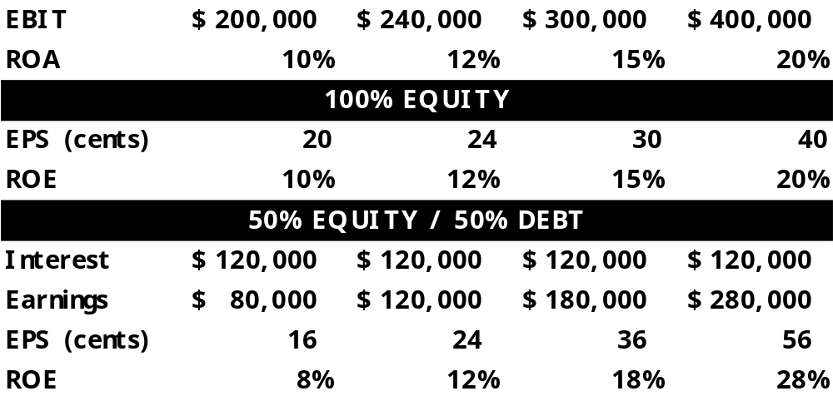
Illustration 1: Effect of Debt on Shareholders
Notes:
Example title for notes and handouts
Example footer for notes and handouts
Effects of Financial Leverage
Expected rate of return on equity is increased
Variability of returns to shareholders increases
Trade-off between risk and return

Slide 7
What is a liability?
According to AASB Framework:
‘A present obligation of the entity arising from past events, the settlement of which is expected to result in an outflow from the entity of resources embodying economic benefits’ (AASB, Framework for the preparation and presentation… para 49)
The definition extends beyond legal obligations

Slide 8
Characteristics of framework definition
Present obligation …
arising from past events
Settlement expected to result in outflow of economic benefit
Let us look at these characteristics more closely…

Slide 9
‘Present obligation’
A duty or responsibility to act or perform in a certain way
Obligation may be:
  Legal
  Equitable (social or moral obligations)
  Constructive (entity’s actions create valid expectations in other parties that certain responsibilities will be discharged)

Slide 10

‘past event’
Some event that led/gave rise to obligation
Examples:
  Purchase of goods
  loan
  use of service
  Other …

Slide 11

Settlement expected to result in an outflow of economic benefit
Settlement/payment expected to decrease assets …
by:
  payment of cash or transfer of other assets
  Provision of service
Liabilities must also meet recognition criteria …

Slide 12
Recognition criteria:
1. Probable sacrifice of economic benefit
  More likely than less likely
  Assessment based on available evidence
2. Reliable measurement
  ‘Reasonable estimate’
Note: Items that meet the definition but not the recognition criteria should be disclosed in the notes to the accounts

Slide 13
Application of definition and recognition criteria cont.
Magazine subscriptions received in December for the following financial year total $30,000.
A company normally pays staff an annual bonus to the value of 1% of their annual salary
A company records an expense each year for machinery repairs that will need to be carried out in the future due to wear and tear on the machine. This results in the recording of a liability? Do you agree with the company’s recording of anticipated repairs?

Slide 14
Application of definition and recognition criteria
Let us consider whether in the case handed out in class a liability should be recorded according to the AASB framework liability definition and recognition criteria …
  What difficulties were experienced in applying the definition and recognition criteria?

Slide 15
More guidance on the recognition of certain liabilities is given in AASB 137 Provisions, contingent liabilities and contingent assets

Slide 16
AASB 137 Provisions, Contingent liabilities and Contingent Assets
Definitions:
  Provisions
    liabilities of uncertain amount and timing (see next slide)
  Contingent liabilities
    Possible obligation that arises from past events that is contingent on a future event
    Present obligation that does not meet recognition criteria ie. not probable or a ‘reasonable estimate cannot be made
    recorded in notes to accounts if material

Slide 17
“Provisions”: how accounted for
Recognised if meet liability definition and recognition criteria AND …
Past event must be an “obligating event” - there is no realistic alternative to settling the obligation due to:
  A legal obligation OR
  The creation of expectations of others of responsibility to settle obligation (paras. 10; 17)
NOTE: a past event is not an ‘obligating’ event if entity can avoid the expenditure by future actions
Where past event is not clear, a past event is assumed if more likely than not, given all available evidence, that obligation exists (paras. 15 & 16).

Slide 18
Provisions: how accounted for cont.
Measurement
  “the use of estimates is an essential part of financial reports and does not undermine their reliability” (para. 25)
  best estimate of expenditure required to settle obligation (para. 36)
  Where effect of time value of money is material the present value of expected expenditure (para. 45)
  If material obligations cannot be measured reliably they must be disclosed in the notes to the reports

Slide 19
Provision vs contingent liability
AASB 137 Appendix B: decision tree for determining whether a transaction or event should be recognised as a provision or disclosed as a contingent liability.
The decision tree is reproduced on the following slide
Notes:
Example title for notes and handouts
Example footer for notes and handouts

Slide 20
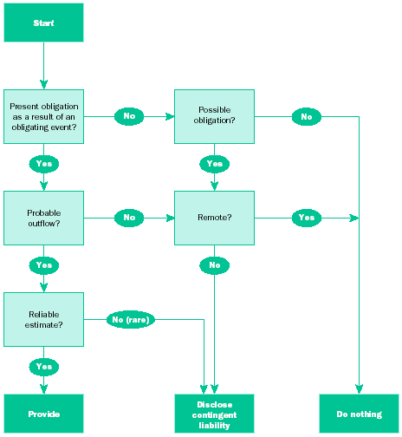
Notes:
Example title for notes and handouts
Example footer for notes and handouts

Slide 21
Are the following “obligations” that should be recorded?
A company plans to restructure its operations by closing a plant and and retrenching 3,000 workers. An advisory company has drawn up detailed restructuring plans which management have approved. The estimated costs of restructuring are $1.3m. Staff have been advised and counselling is to begin next week.
Sales of products during the period total $100,000. All products are issued with warranties. Past experience has shown that 2% of products are returned under warranty for repair.

Slide 22
Liabilities and economic consequences
How liabilities are measured and disclosed will affect contractual arrangements tied in part to liabilities
  For example, debt-to-asset constraints
It is hypothesised that:
  managers in firms close to breaching debt covenants will choose accounting methods that:
    increase income (thereby assets and owners’ equity), or
    decrease debt
  whether or not particular accounting methods are chosen will be influenced by the costs of breaching debt covenants
Notes:
Example title for notes and handouts
Example footer for notes and handouts

Slide 23
Revision
1. Which of the following meet the AASB definition of liabilities?
a) Employee superannuation entitlements
b) costs incurred during the period in repairing products sold in the previous financial year under warranty
c) the costs of maintenance, needed as a result of breakdowns this financial year, which will be carried out in the next financial year
d) all of the above
e) a) and b)
f) a) and c)
2. Which of the following would not meet the requirement of an ‘obligating event’ at the end of the financial year?
(a) An oil company operating in a country where there is no environmental legislation causes contamination of a local river. The entity has a widely published environmental policy in which it undertakes to clean up all contamination that it causes.
(b) New legislation requires the fitting of safety devices on all factory machines within 12 months. Entity A has machines in its factory which do not have safety devices fitted
(c) Company B decided to close one of its factories. A detailed plan of the closure has been drawn up, letters have been sent to customers advising them of the closure, and redundancy notices have been sent to factory staff. The cost is estimated to be $60,000.
(d) none of the above would meet the requirement
(e) (a) (b) and (c) would meet the requirement

Slide 24
Revision
In a constructive obligation where the entity retains discretion to avoid any future sacrifice of economic benefits, no liability should be recognised in the financial statements.
A: True
B: False
In accordance with AASB 137 “Provisions, Contingent Liabilities and Contingent Assets”, a contingent liability must be disclosed in the financial statement even when the likelihood of a present obligation occurring in future is remote.
A: True
B: False
A guarantee provided to a financier for a loan taken out by another entity, where default on that loan is uncertain as at the reporting date, is an example of a contingent liability:
A. True
B. False
Provisions are established to allow for future sacrifices such as repairs and maintenance of machinery and may be recognised as liabilities:
A. True
B. False
A necessary condition for a provision to be recognised is that there is a legal obligation to make a future sacrifice of economic benefits:
A. True
B. False
Notes:
Example title for notes and handouts
Example footer for notes and handouts

Slide 25
Owners’ equity
Defined as residual interest ie. assets - liabilities = owners’ equity
Rights of parties generally distinguish owners and lenders, HOWEVER:
The distinction between liabilities and equity is not always clear eg. Convertible notes and redeemable preference shares.
Let us consider some examples …

Slide 26
Liabilities or owners’ equity? ie. Is there a ‘present obligation’?
Convertible notes: interest payments for defined period then can be converted to shares at option of holder (AASB132: debt and equity components to be accounted for separately)
Redeemable preference shares. Fixed interest payments but not fixed term. Can be redeemed for cash (AASB132: where redeemable on specific date at option of holder to be recorded as debt)
Let us consider redeemable preference shares …

Slide 27
Question
In 2004 Alpha Company issued 8% redeemable preference shares with a face value of $10, redeemable at the option of the holder. The shares are redeemable on 28 February 2009. At 31 December 2008 interest rates have fallen and are expected to fall even further. The reserve bank cash rate is 4.25%.
Discuss whether the redeemable preference shares meet the AASB liability definition and recognition criteria at 31 December 2008.

Slide 28
Debt vs equity and economic consequences
All things being equal, firms typically prefer to disclose low levels of debt
When faced with a need for additional funds, firms might issue debt-like securities labelled as equity
  For example, redeemable preference shares
  Associated distributions are termed dividends (i.e. distributions of profits), not expenses
If securities are defined as ‘debt’:
  associated payments are treated as interest reducing profits
Notes:
Example title for notes and handouts
Example footer for notes and handouts

Slide 29
Debt vs equity and economic consequences cont.
AASB 132 Financial Instruments: Presentation
  The substance rather than the legal form of a financial instrument governs its classification on the balance sheet
  Therefore some preference shares are financial liabilities
Requirement to treat preference shares as debt can have significant implications for debt-to-assets ratio
Refer to Worked Example 10.3 (p. 342)—Impact of classifying preference shares as debt, rather than equity
Notes:
Example title for notes and handouts
Example footer for notes and handouts

Slide 30
Critique of framework definitions and recognition criteria
‘Liabilities’:
  Reliability (unbiased; trustworthy; verifiable)
    May be difficult to determine whether there is a ‘present obligation’ and/or past event
    ‘reliable measurement’ ambiguous
    estimates subjective and not verifiable
  Comparability
    probability and reasonable estimates subjective
‘Owners equity’: not defined!

Slide 31
Summary
Accounting notion of liabilities not limited to legal obligations
Liabilities in accounting are defined as present obligations to sacrifice resources in the future as a result of past event/s
AASB 137 provides more guidance on accounting for liabilities or potential liabilities
Owners’ equity is defined as a residual
Some instruments have characteristics of both debt and equity. Economic substance needs to be considered.
Ambiguous definitions and recognition criteria
Inconsistencies between standards and CF

